Slide 1
MyHealth EMRKS
Dustin Salentiny
Jeffery Schafer
Jordan Torres

Slide 2
What EMRKS is
EMRKS is an electronic record system to maintain information about patients in an easy to use format online.
Allows authorized users to access their own files via web, pda, or other easy access methods.
A paperless system which provides portability

Slide 3
EMRKS features
Secure login screen so content is not available to everyone.
Security checks on data so unauthorized access is prohibited.
Easy to use system with functionality for each different user type.
Easy to maintain as new updates are not difficult to make.
Collaborated data into easy viewing for users.

Slide 4
EMRKS features (cont'd)
6. Access time is lessened due to centralized access of
records. This saves on doctor, patient, and other
faculty staff access times.
7. Accidental loss including fires, misplacement, and theft
are minimized due to online backup and storage of
paper-less files. It means more worry-free storage.
8. Money is saved due to decreased access time of
records and reduced paper waste
9. Other than the initial cost of startup,
maintenance should be cheap.

Slide 5
User case 1
Physicians
* Access to EMRKS
* Able to view patients history
* Date visit
* Attenting physician
* Attending nurse, etc.
* Enter patients visit details
* Date visit
* Comments, etc.

Slide 6
User case 2
Patients
* Access to EMRKS
* View his/hers info
* Phone number
* Email address
* View his/hers medical history
* Schedule/update an appointment
* View Billing information
* Specific dates of billing
* Total cost/paid to facility

Slide 7
User case 3
Accountant
* Access to EMRKS
* Access to billing reports
* Date of charge
* Amount billed
* Amount charged
* Payment processing
* Make payment on multiple bills
* Include comments
* Verify account balances

Slide 8
User case 4
Customer Support
* Can deal with appointments:
* Make new appointment
* Reschedule old appointment
* Delete an appointment

Slide 9
User Case 5
Nurses
* Patients Record Retrieval
* Patient Visitation Detail Submission

Slide 10
User Case 6
Pharmacists
* Patient Prescriptions
* Filling prescriptions and updating inventory
* Pharmacological Inventory
* Purchasing new stock.
* Maintaining current stock

Slide 11
User Case 7
Facility Staff
* Rooms that need Clearning
* Retrieve Equipment Move Requests
* Find Equipment Location

Slide 12
User Case 8
Auditors
* Billing Audit
* Able to see hospital expenses and review
purchases.
* Pharmacy Audit
* Review of purchases of new medication
along with quantities.

Slide 13
User Case 9
Receptionists
* Patient Scheduling
* Approves schedule changes/requests.
* Can delete appointments if necessary.
* Registering Payment
* Can pass payment onto billing section.

Slide 14
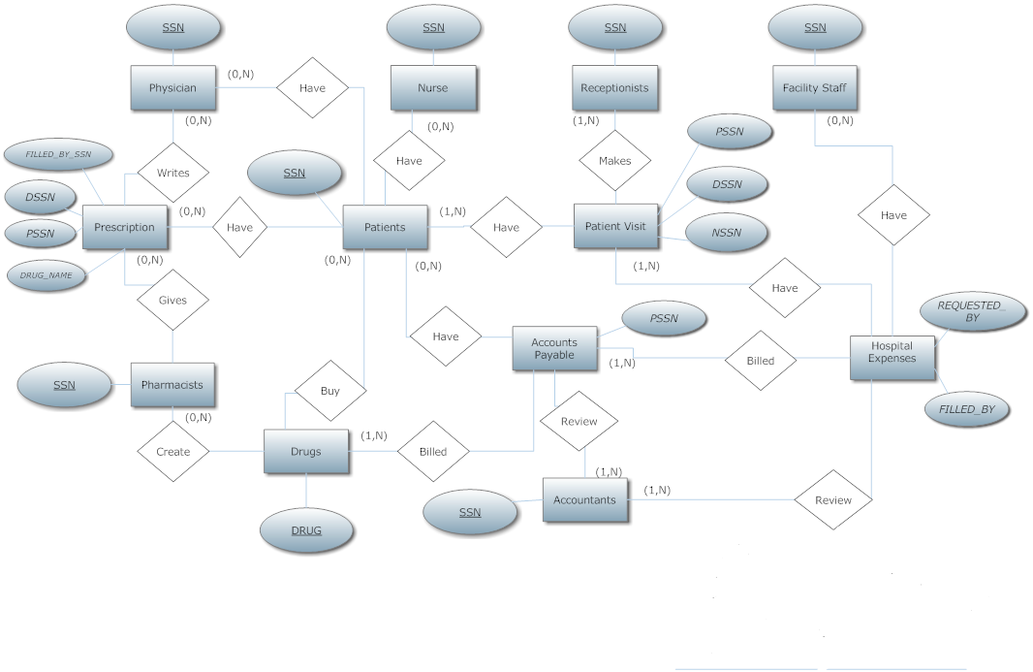
ER diagram

Slide 15
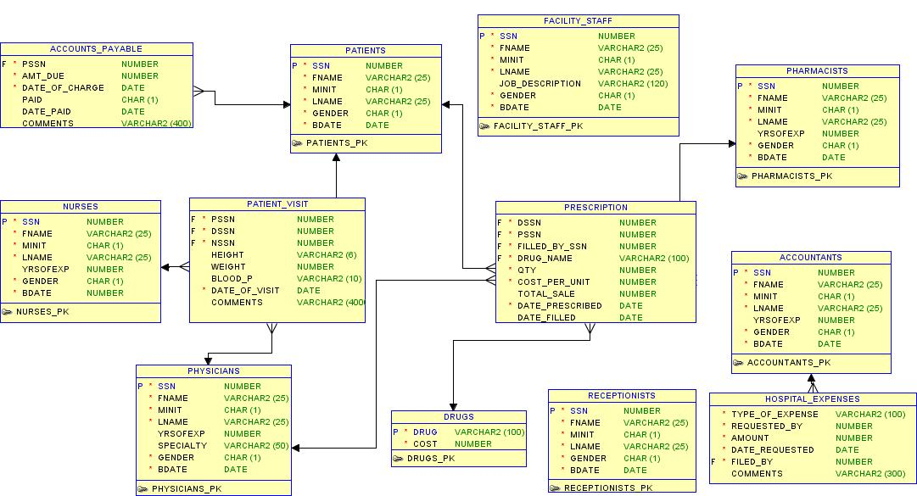
Schema diagram
Remember 60-90 seconds worth of bull shit per slide

Slide 16
Our implementation methods
Web-based EMRKS.
Tools and methods used:
Debian 5/Linux 2.6.28
MySQL 5.0.75
PHP 5.2.6
Subversion 1.5.4
Xcode/gedit/notepad/Dreamweaver
Photoshop CS3

Slide 17
Our implementation methods (cont'd)
Authentication method:
Username is hashed using MD5.
This prevents simple username lookups.
Password is an MD5 hash with salts.
This increases the attack time required.
mysql> select username,password from users; +-----------------------------------------------+----------------------------------------------------------------------+ | username | password | +-----------------------------------------------+----------------------------------------------------------------------+ | b39024efbc6de61976f585c8421c6bba | 83bb4a7b1c3e3fd184a2eab9af5b33c68dc5b0a1b810fe9fa | | 098f6bcd4621d373cade4e832627b4f6 | 3a67c3d12a1023b3d7f5e6b6e6b4e6c61d0b62d45546581a6 | | c7622c1e0f716dc3b121bc1db7b6cb4e | f8cc6b18643cc67ea29ac416a09d57318902770d62fde9957 |
.
.
.

Slide 18
Our implementation methods (cont'd)
The average screen layout pattern:
(Name of user-action).php file
<includes.php> -- Security/session check
<database.php> -- Maintains database connections
<header.php> -- Primary theme
<body_start.php> -- Secondary theme
Program, display, and db query code go here.
<body_end.php> -- End secondary theme
<footer.php> -- End primary theme

Slide 19
Difficulties & solutions encountered
Subversion/Google Docs
Allowed virtually seamless collaboration
Size of project/time requirement
Meet-up times were difficult
Lack of graphical skills/experience
Password length/strength policy
Currently, no enforcement
Stricter privacy mechanisms
Any doctor can see any patient if ID is known
Familiarity with medical procedures/facilities
Lack of "insider experience" or reference

Slide 20
Demo
* Demonstrate typical usage for:
* Physician
* Accountant
* Patient
**While there is much more functionality and more users for the system due to time constraints we will show you basic usage**

Slide 21
Questions?

Slide 22
Thank you!

